Slide 1
How to define and manage work orders in Alma
Yoel Kortick
Senior Librarian

Slide 2

Agenda
Introduction
Work Order Types
Work Order Type Departments
Work Order Type Statuses
Creating Work Orders
Managing Work Orders
Completing Work Orders

Slide 3
Introduction

Slide 4
Introduction
A work order is an internal library request to route physical materials for internal processing.
A work order sends an item to a work order department (marking it as not available on the shelf), where it can be managed according to internal statuses.
Both departments and statuses are configurable and can be used to manage tasks according to a library’s local needs.
A work order type indicates the type of library process to be carried out on a resource, such as binding or cataloging.

Slide 5
Introduction
Each work order type has at least one department, and it is common to have only one department.
The department is a place in the library where the actual work on the work order type is done
Each work order type has at least one status, but typically several.
For example: a work order of type "binding" could have statuses "gluing", "sewing", and so forth, while a work order of type "digitization" could have statuses "in scanning room", "digitizing", "document delivery", and so forth.

Slide 6
Introduction
In the example here we will make a work order type called "Conservation" which uses the department "Conservation Laboratory".
This sample work order type includes four distinct statuses, each representing different activities which may be done on items in the conservation department:
Initial Evaluation
Fumigation
Mending and Filling
Sewing and Rebinding

Slide 7
Introduction
We will now look at a specific example.
First, we will look at the work order type
Then we will look at the work order department of the specific type

Slide 8
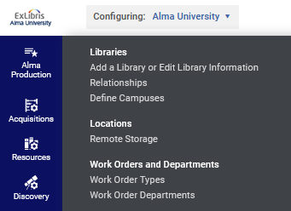
Introduction
Configuration > General > Choose Institution (not specific library) > Work Orders and Departments > Work Order Types
Institution level (not library level)

Slide 9
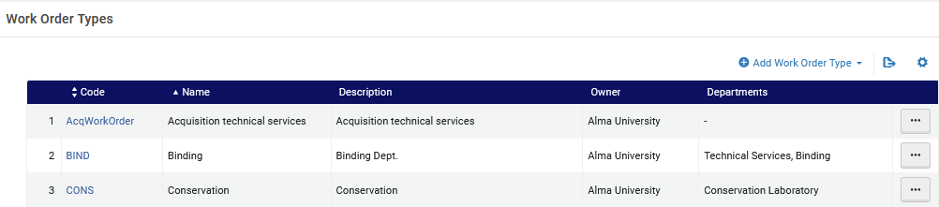
Introduction
This is a work order type named "Conservation" which uses the department "Conservation Laboratory"

Slide 10
Introduction
Configuration > General > Choose Institution (not specific library) > Work Orders and Departments > Work Order Departments
Institution level (not library level)

Slide 11
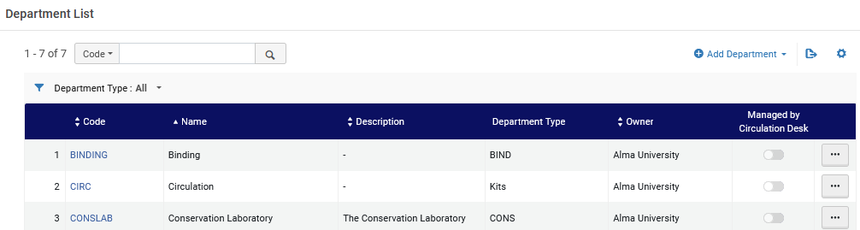
Introduction
This is the work order department called "Conservation Laboratory"

Slide 12
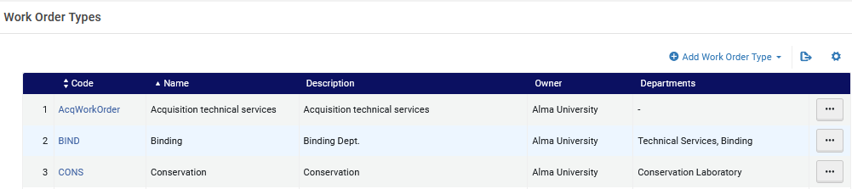
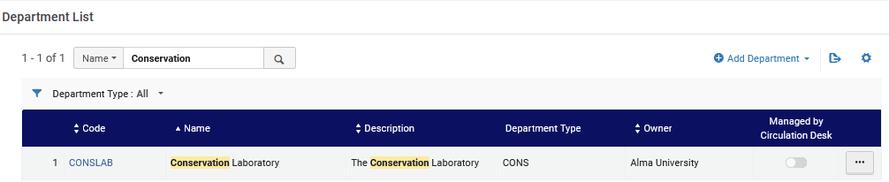
Introduction
The Department "Conservation Laboratory" is designed to handle Work Order Type "Conservation"

Slide 13
Work Order Types

Slide 14
Work Order Types
The Work Order Type needs to be created before the Department and Statuses.
This is because the departments and statuses are each connected to an existing work order type.
The work order type is created at "Configuration > General > Work Orders and Departments > Work Order Types > Add Work Order Type"
Institution level (not library level)

Slide 15
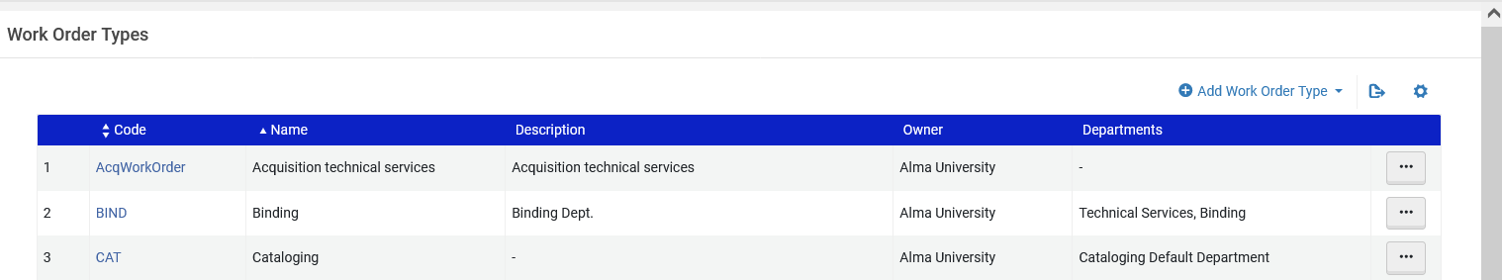
Work Order Types

Slide 16
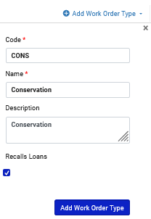
Work Order Types
Here we add work order type "Conservation".
The initial definitions consist of a code, name, description and if it recalls loans

Slide 17
Work Order Types
The initial definitions consist of a code, name, description and if it recalls loans
This means that if a work order request is made on an item and the item is on loan the loan will be recalled

Slide 18
Work Order Type Departments

Slide 19
Work Order Type Departments
The Work Order Departments may be added in two ways:
Access the work order types list at "Configuration > General > Work Orders and Departments > Work Order Types" and from the relevant type choose "Actions" > Manage Departments > Add Department"
Access the work order departments list at "Configuration > General > Work Orders and Departments > Work Order Departments" and from the list click "Add Department" and choose the corresponding existing work order type.

Slide 20
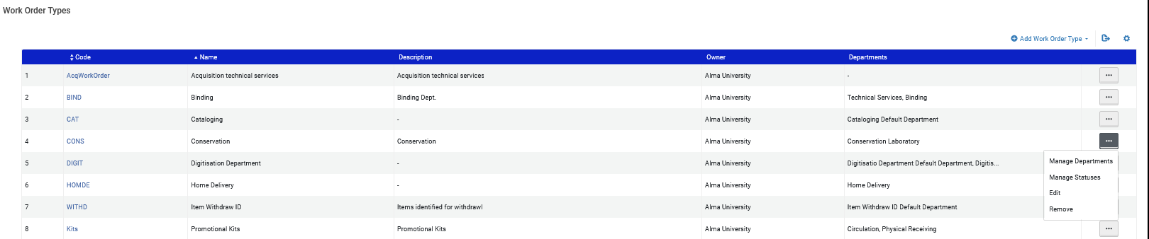
Work Order Type Departments
Adding a department from the work order types list

Slide 21
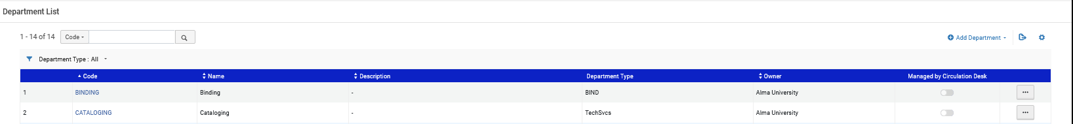
Work Order Type Departments
Adding a department from the work order departments list

Slide 22
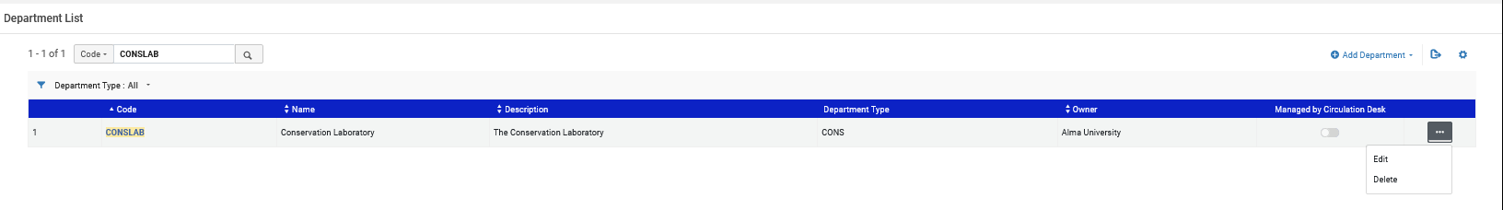
Work Order Type Departments
Work order type "Conservation" has a department called "Conservation Laboratory".
Here we are editing the department called "Conservation Laboratory" in order to see how it is defined

Slide 23
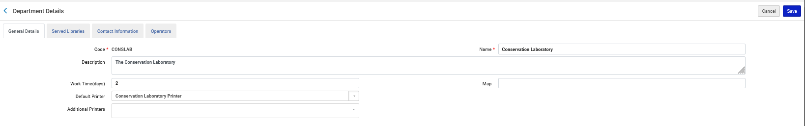
Work Order Type Departments
The "Conservation Materials Laboratory" Department
The "Work Time Days" define how long the item is expected to remain in the department

Slide 24
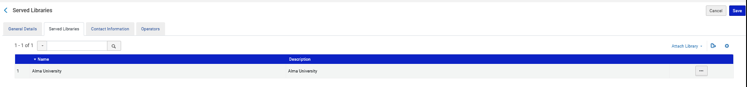
Work Order Type Departments
The "Conservation Materials Laboratory" Department
The department can serve the entire Institution or only particular libraries. Here we have defined that it serves the entire institution.

Slide 25
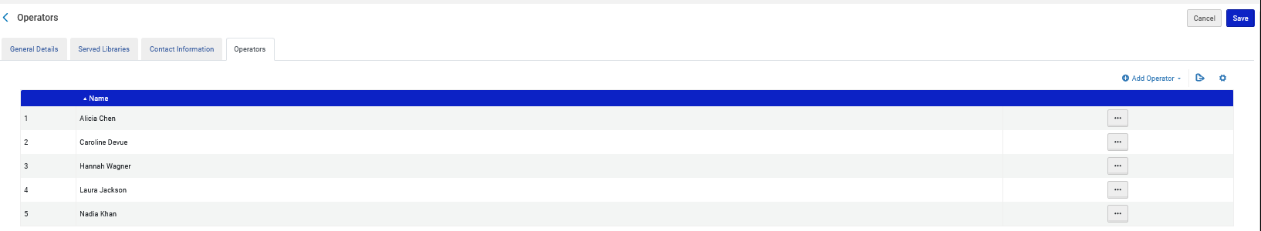
Work Order Type Departments
The "Conservation Materials Laboratory" Department
Only the operators registered for the department will be able to access it in the "Currently at" section of the interface. Other users can make requests for the department, but only registered operators can handle the request.

Slide 26
Work Order Type Statuses

Slide 27
Work Order Type Statuses
The Work Order Statuses consist of three fields:
Code
Name
Description
The Work Order Statuses are added as follows:
Access the work order types list at "Configuration > General > Work Orders and Departments > Work Order Types" and from the relevant type choose "Actions" > Manage Statuses"

Slide 28
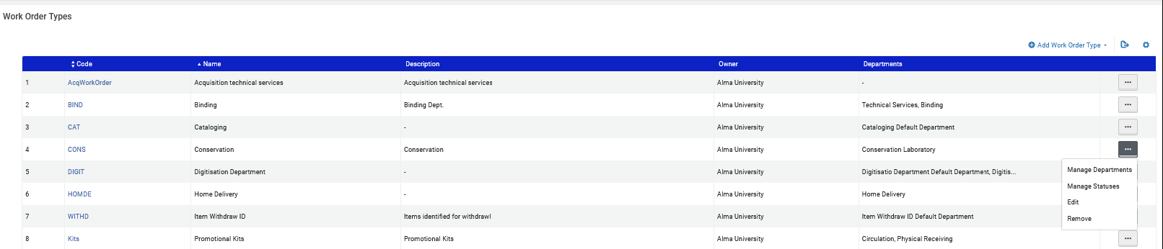
Work Order Type Statuses

Slide 29
Work Order Type Statuses
Work order type "Conservation Materials" has four statuses:
Conservation Material Initial Evaluation
Conservation Material Fumigation
Conservation Material Mending and Filling
Conservation Material Sewing and Rebinding

Slide 30
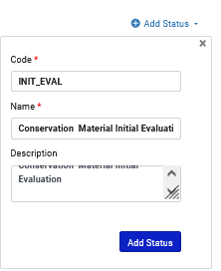
Work Order Type Statuses
We will add the first of the four statuses four statuses:

Slide 31
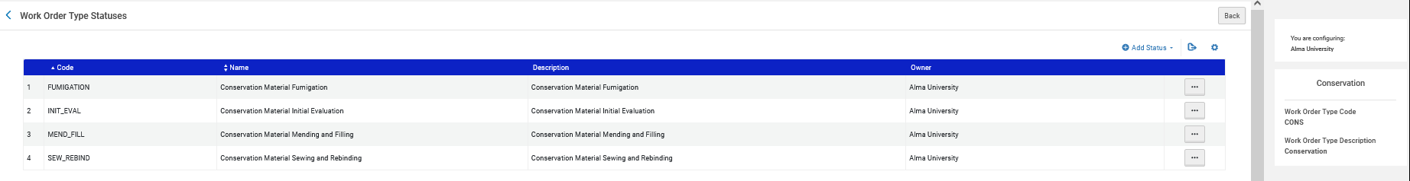
Work Order Type Statuses
We have added all four statuses:
These are the four statuses for Work Order Type "Conservation"

Slide 32
Creating Work Orders

Slide 33
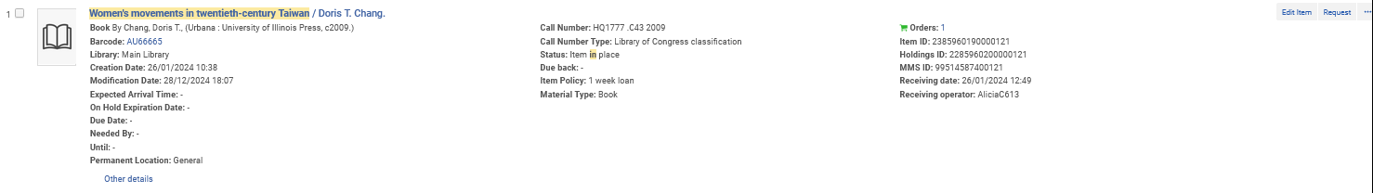
Creating Work Orders
The title "Women's movements in twentieth-century Taiwan" has one item with barcode AU66665:
The item is current in place in the Main Library

Slide 34
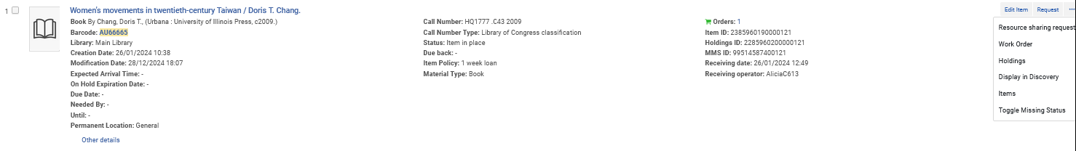
Creating Work Orders
The item (barcode AU66665) needs to go to the conservation laboratory for fixing the binding, so the staff will create a work order.
Here we create a work order from the physical items repository search.

Slide 35
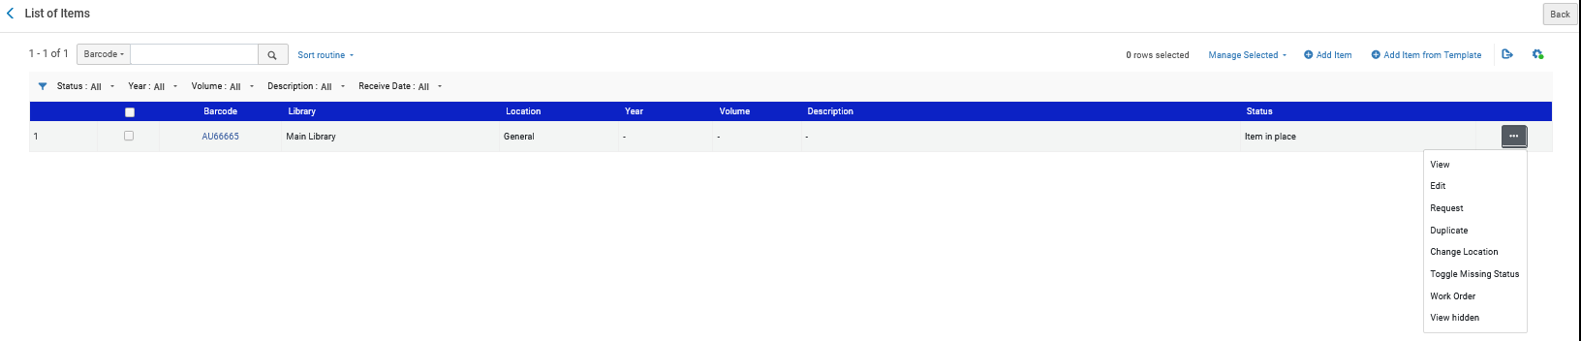
Creating Work Orders
Note that the Work Order can also be created from the list of items

Slide 36
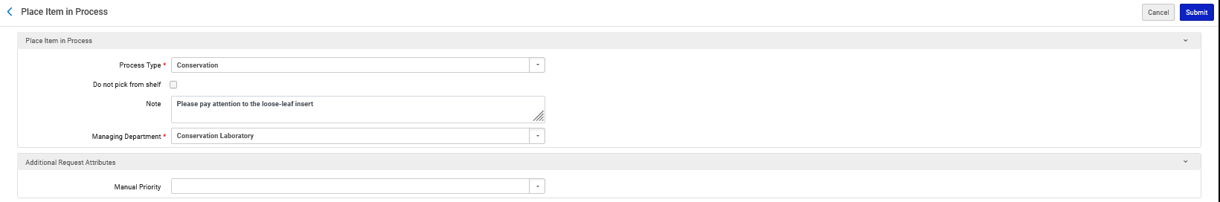
Creating Work Orders
When creating the working: From the pull-down box we choose Process Type "Conservation" and Department "Conservation Laboratory"
If we already have the item in hand hand,check "Do not pick from shelf"
This note will later appear on the resource request slip and on the item transfer slip
The Process Type and Department

Slide 37
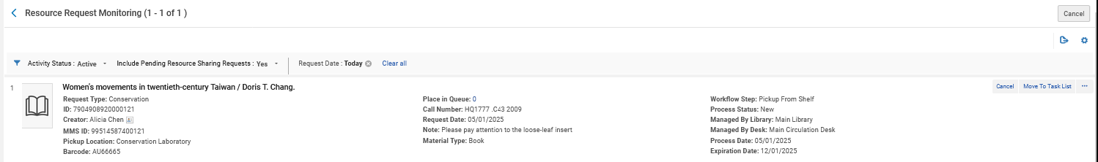
Creating Work Orders
A request is created for the Work Order and appears at "Fulfillment > Resource Requests > Monitor Requests & Item Processes"
The current status is "Pickup From Shelf"

Slide 38
Managing Work Orders

Slide 39
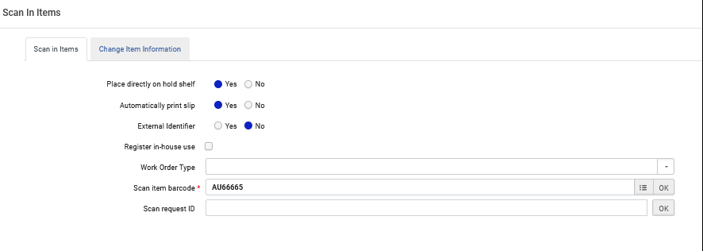
Managing Work Orders
The fulfillment librarian takes item and scans it in at the circulation desk of the owning library (Fulfillment > Resource Requests > Scan In Items)

Slide 40
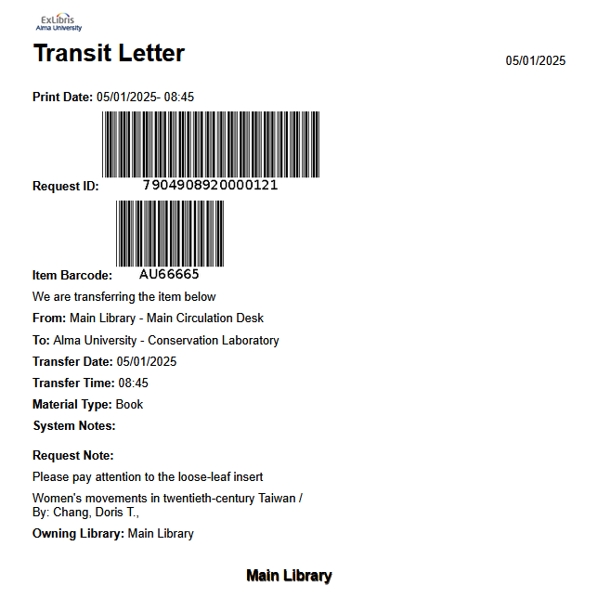
Managing Work Orders
A transit letter is printed (depending on print definitions)
Transfer from the Main Library to the Conservation Laboratory
This is the Note we earlier added when creating the Work Order

Slide 41
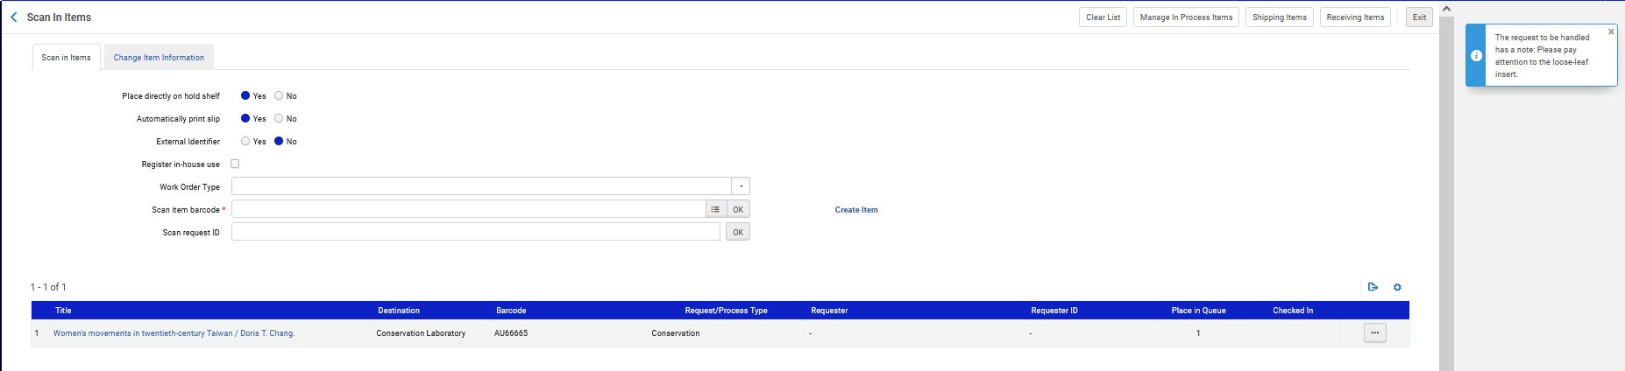
Managing Work Orders
This is the note we added when creating the work order
When scanning in the item the staff user sees that this item needs to go to destination the "Conservation Laboratory"

Slide 42
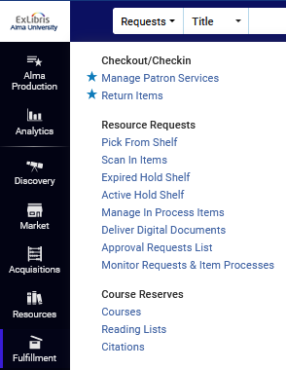
Managing Work Orders
At any time, the fulfillment librarian can choose to "Monitor Requests & Item Processes"

Slide 43
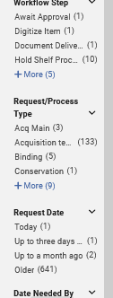
Managing Work Orders
And facet by only those in Request/Process Type "Conservation"

Slide 44
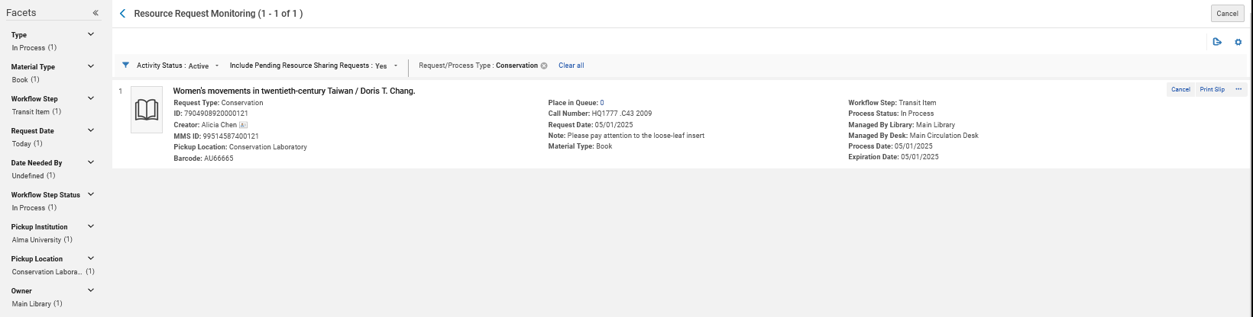
Managing Work Orders
We have faceted by Request/Process Type "Conservation"
The workflow step is currently “Transit Item"

Slide 45
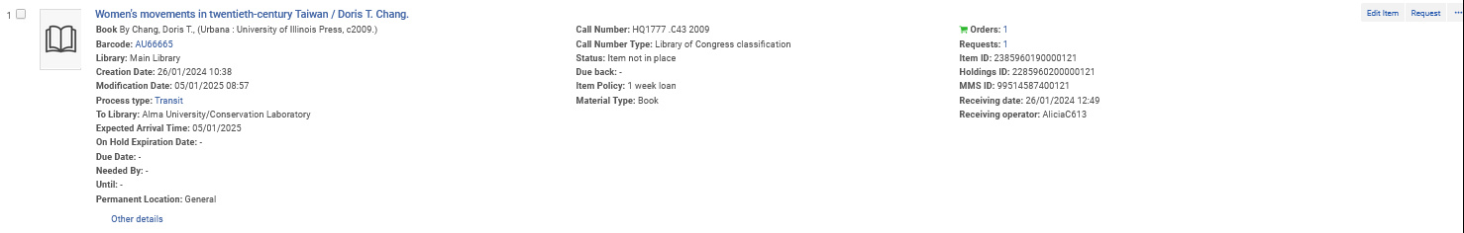
Managing Work Orders
The repository search also shows that this item is in transit to the Conservation Laboratory

Slide 46

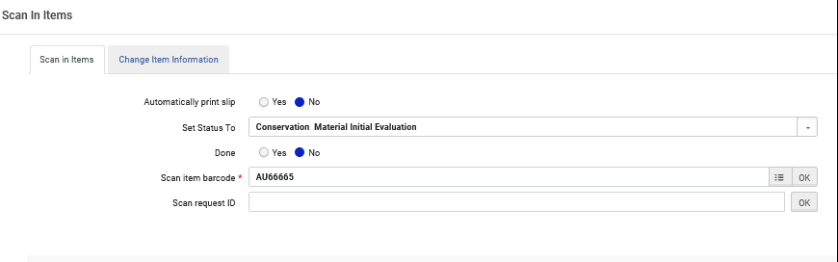
Managing Work Orders
We will scan in the item at the "Conservation Laboratory" and set status to "Conservation Material Initial Evaluation"
While scanning in we will set the status to “Conservation Material Initial Evaluation”

Slide 47
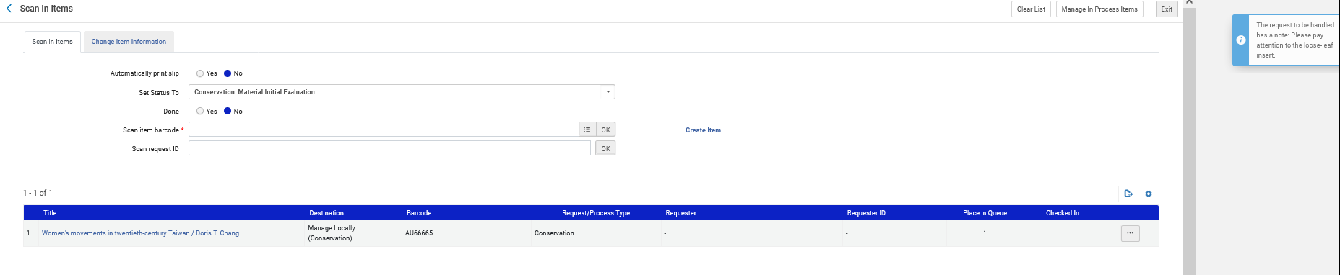
Managing Work Orders
The item has been scanned in and is being managed locally
This is the note we added when creating the work order

Slide 48
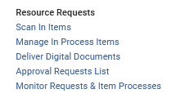
Managing Work Orders
At any time, the staff user at the Conservation Laboratory can choose "Fulfillment > Resource Requests > Manage In Process Items" to get a real-time list of all items in the department

Slide 49
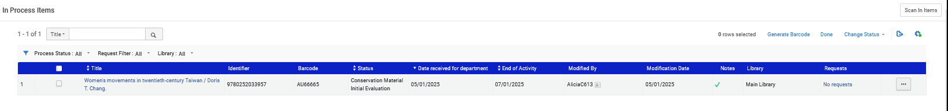
Managing Work Orders
Manage In Process Items
Soon we will do “Change Status”
The work orders can searched by various indexes
The work orders can be filtered by various statuses
The reason the "End of activity is two days later than the "Date received at department" is because in the "general details" tab of the department we defined "Work time (days)" as "2".

Slide 50
Managing Work Orders
While the item is in the Conservation Laboratory the status of the work order changes accordingly.
When we first scanned it in we gave it status "Conservation Material Initial Evaluation".
Now we have completed the initial evaluation and will change it to status "Conservation Material Sewing and Rebinding"

Slide 51
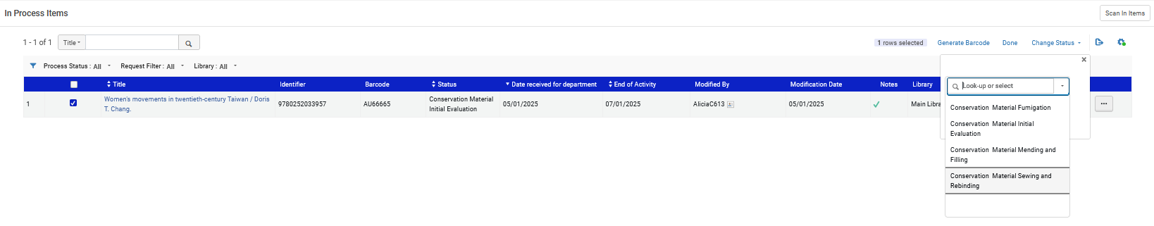
Managing Work Orders
Change status to "Conservation Material Sewing and Rebinding"

Slide 52
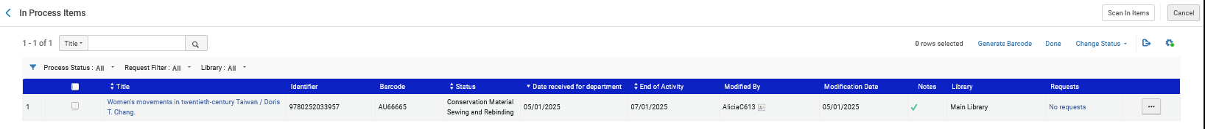
Managing Work Orders
The status has changed

Slide 53
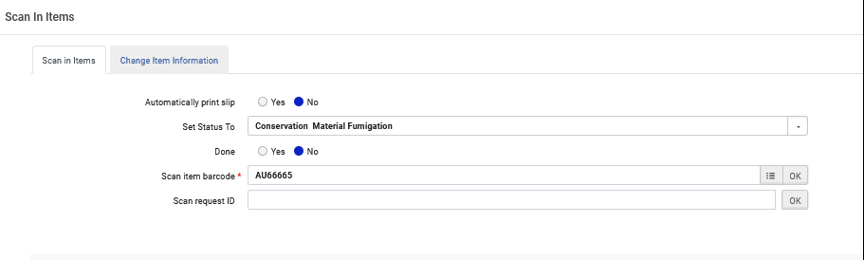
Managing Work Orders
It is also possible to change the status by scanning it in at the Conservation Materials Laboratory via "Fulfillment > Resource Requests > Scan In Items"
Now we are changing the status to “Conservation Material Fumigation”

Slide 54
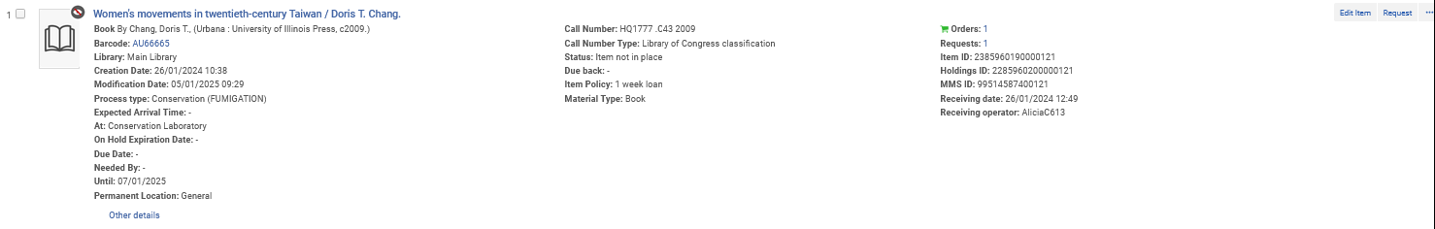
Managing Work Orders
The status and location also appears in the repository search

Slide 55
Completing Work Orders

Slide 56
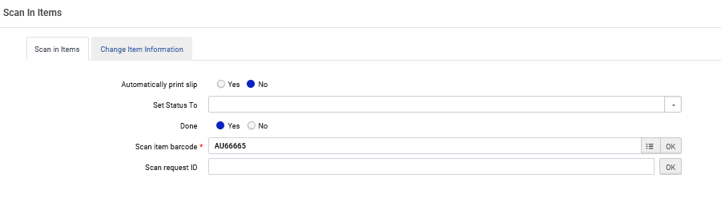
Completing Work Orders
  When all work is complete it is possible to change the Work order to "Done" when scanning it in and choosing the radio button "Yes" for "Done"

Slide 57
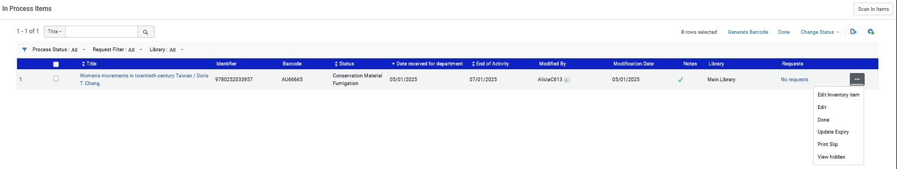
Completing Work Orders
  It is also possible to change the status to "Done" from the "Manage in process items"
Multiple work orders can be changed to done by selecting the in process items and clicking "done"

Slide 58
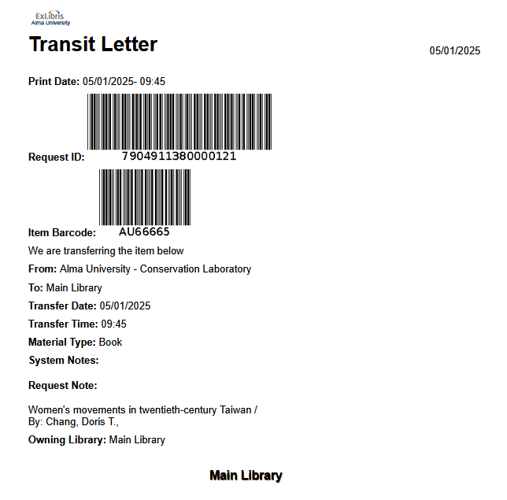
Completing Work Orders
  A transit letter is printed (depending on printing definitions)
From the Conservation Laboratory to the Main Library

Slide 59
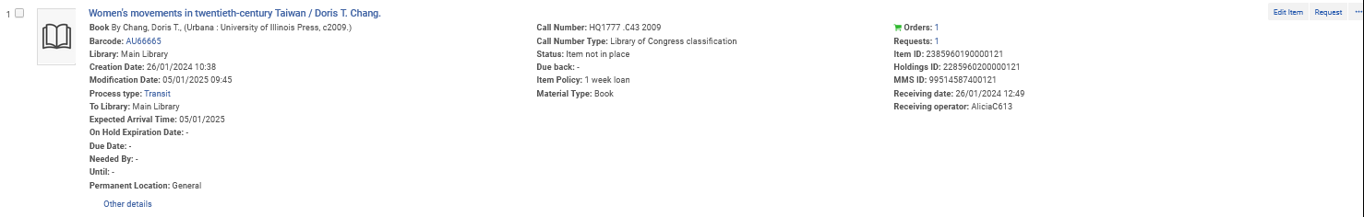
Completing Work Orders
  When the work order is done it becomes "In Transit" to the owning library.

Slide 60

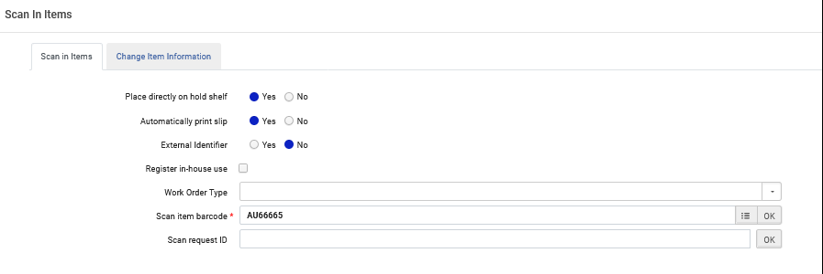
Completing Work Orders
  When the item arrives at the owning library it is scanned in and the process is complete

Slide 61
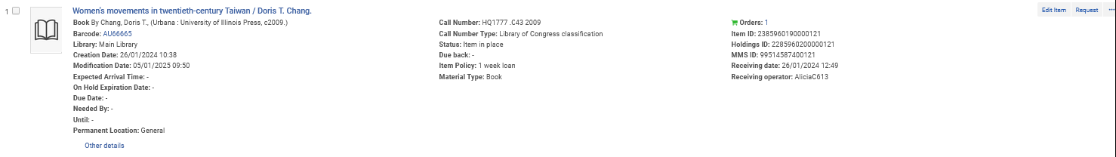
Completing Work Orders
  Item is back in place and the process is complete

